Slide 1
Computational Chemistry
Lecture 8: Reaction Thermodynamics and Kinetics

Slide 2
Reaction Thermodynamics and Kinetics
Connection between QM and Thermodynamics & Ideal Gas Thermodynamics
Reaction Thermodynamics
Reaction Kinetics

Slide 3
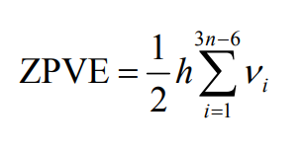

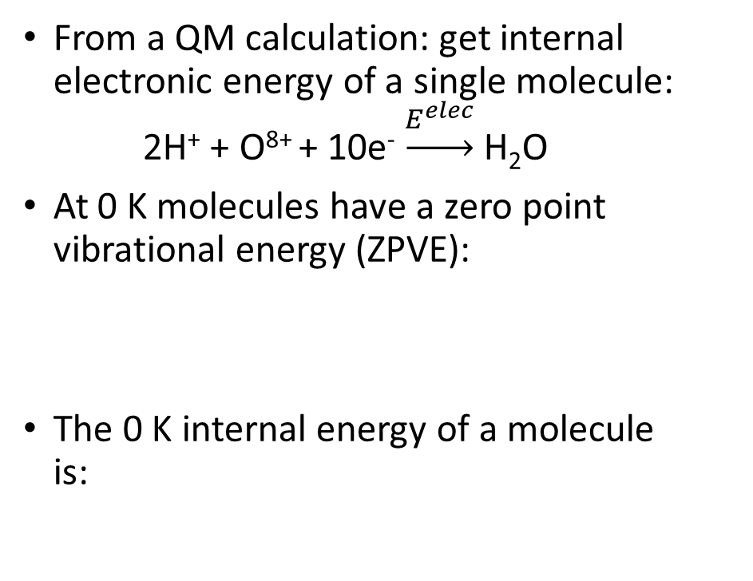
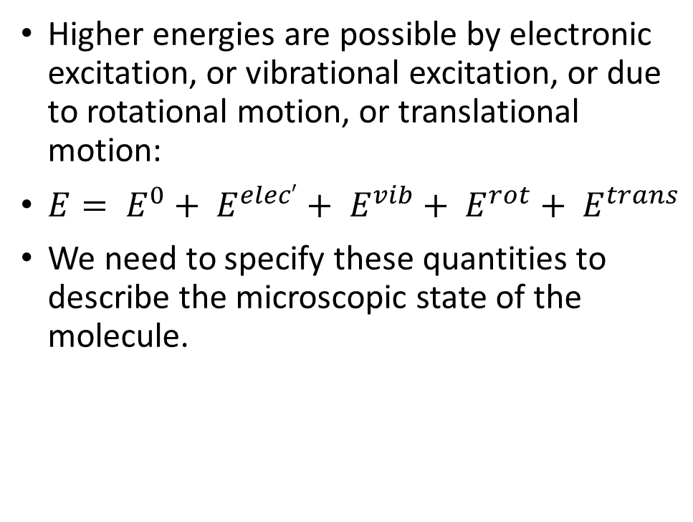
Connection between QM and Thermodynamics
From a QM calculation: get internal electronic energy of a single molecule: 2H⁺ + O⁸⁺ + 10e⁻ $\underset{→}{E^{elec}}$ H₂O
At 0 K molecules have a zero point vibrational energy (ZPVE):
The 0 K internal energy of a molecule is:
Higher energies are possible by electronic excitation, or vibrational excitation, or due to rotational motion, or translational motion:
$E= E^{0}+ E^{elec′}+ E^{vib}+ E^{rot}+ E^{trans}$
We need to specify these quantities to describe the microscopic state of the molecule.

Slide 4

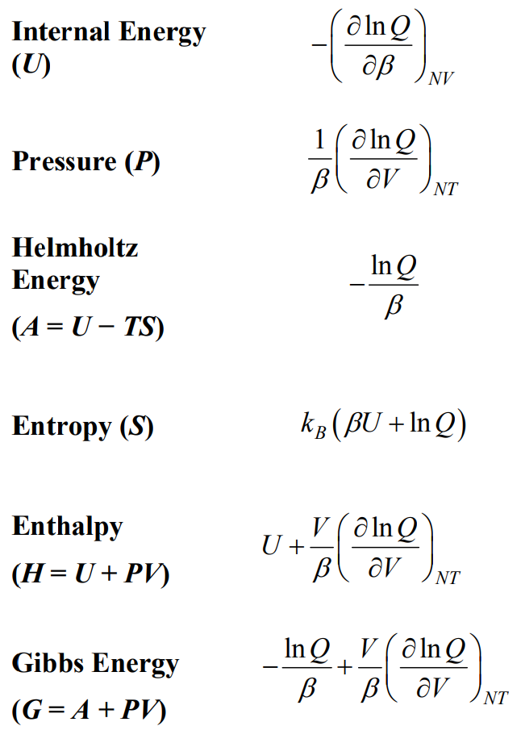
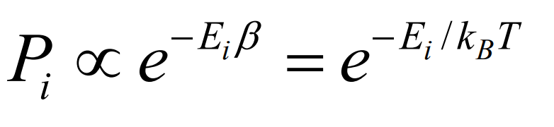
Connection between QM and Thermodynamics
Macroscopically we want the ensemble average of quantities (U, S, H…) at some specified externally imposed set of thermodynamic conditions (T, P…).
In canonical ensemble (N, V, T), the relative probability of a molecule being in a state with energy E_{i} above E⁰ is given by the Boltzmann factor:
Sum over all states is the partition function:
All thermodynamic quantities can be derived from Q

Slide 5
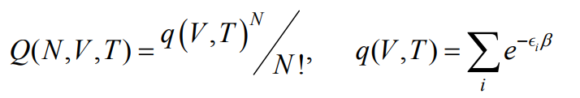

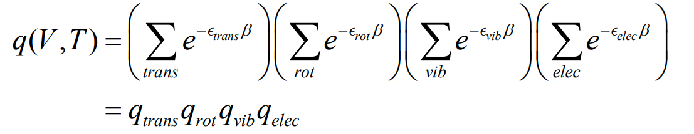
Ideal Gas Thermodynamics
For an ideal gas of N indistinguishable molecules:
Decoupling the molecular partition function:
Typical values:
q^{trans} ≈ 10³⁰, q^{rot} ≈ 100, q^{vib} ≈, q^{elec} ≈ g₀
Quantities:
Translation: Particle in a 3-D box
Rotation: Rigid Rotor
Vibration: Harmonic Oscillator
Electronic: Sum over excited electronic states

Slide 6
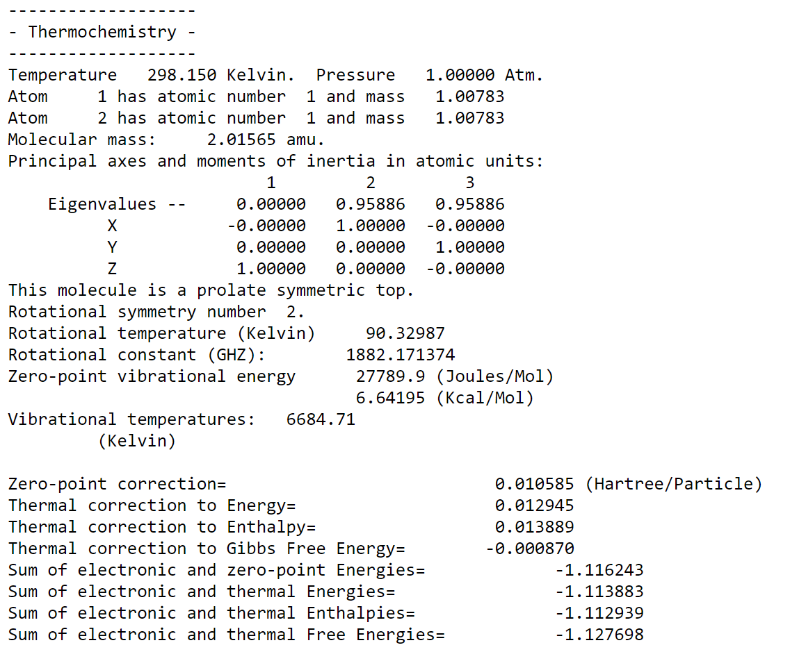
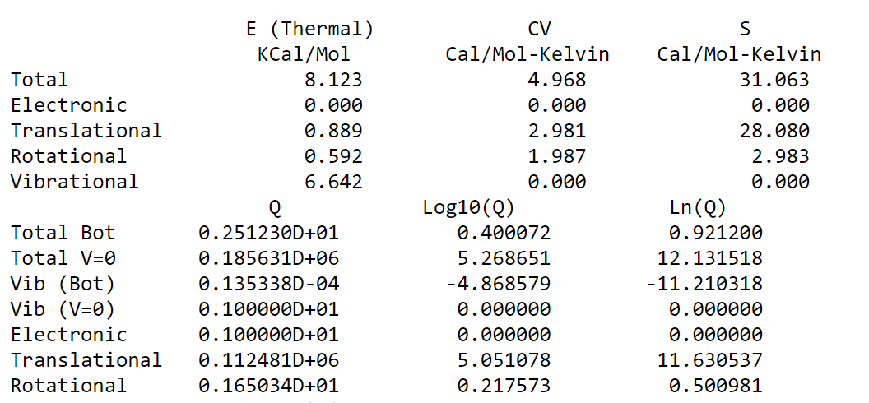

H₂ Example from Gaussian
Calculate vibrational frequencies of H₂ at HF/6-31G level.
E^{elec}:
ZPVE:
E⁰:
E(0-298):
E(298):
H(298):
G(298):

